Slide 1
Human Impact on Climate Change
V.Sravanthi Design Engineer Chipweave Technologies Pvt Ltd

Slide 2
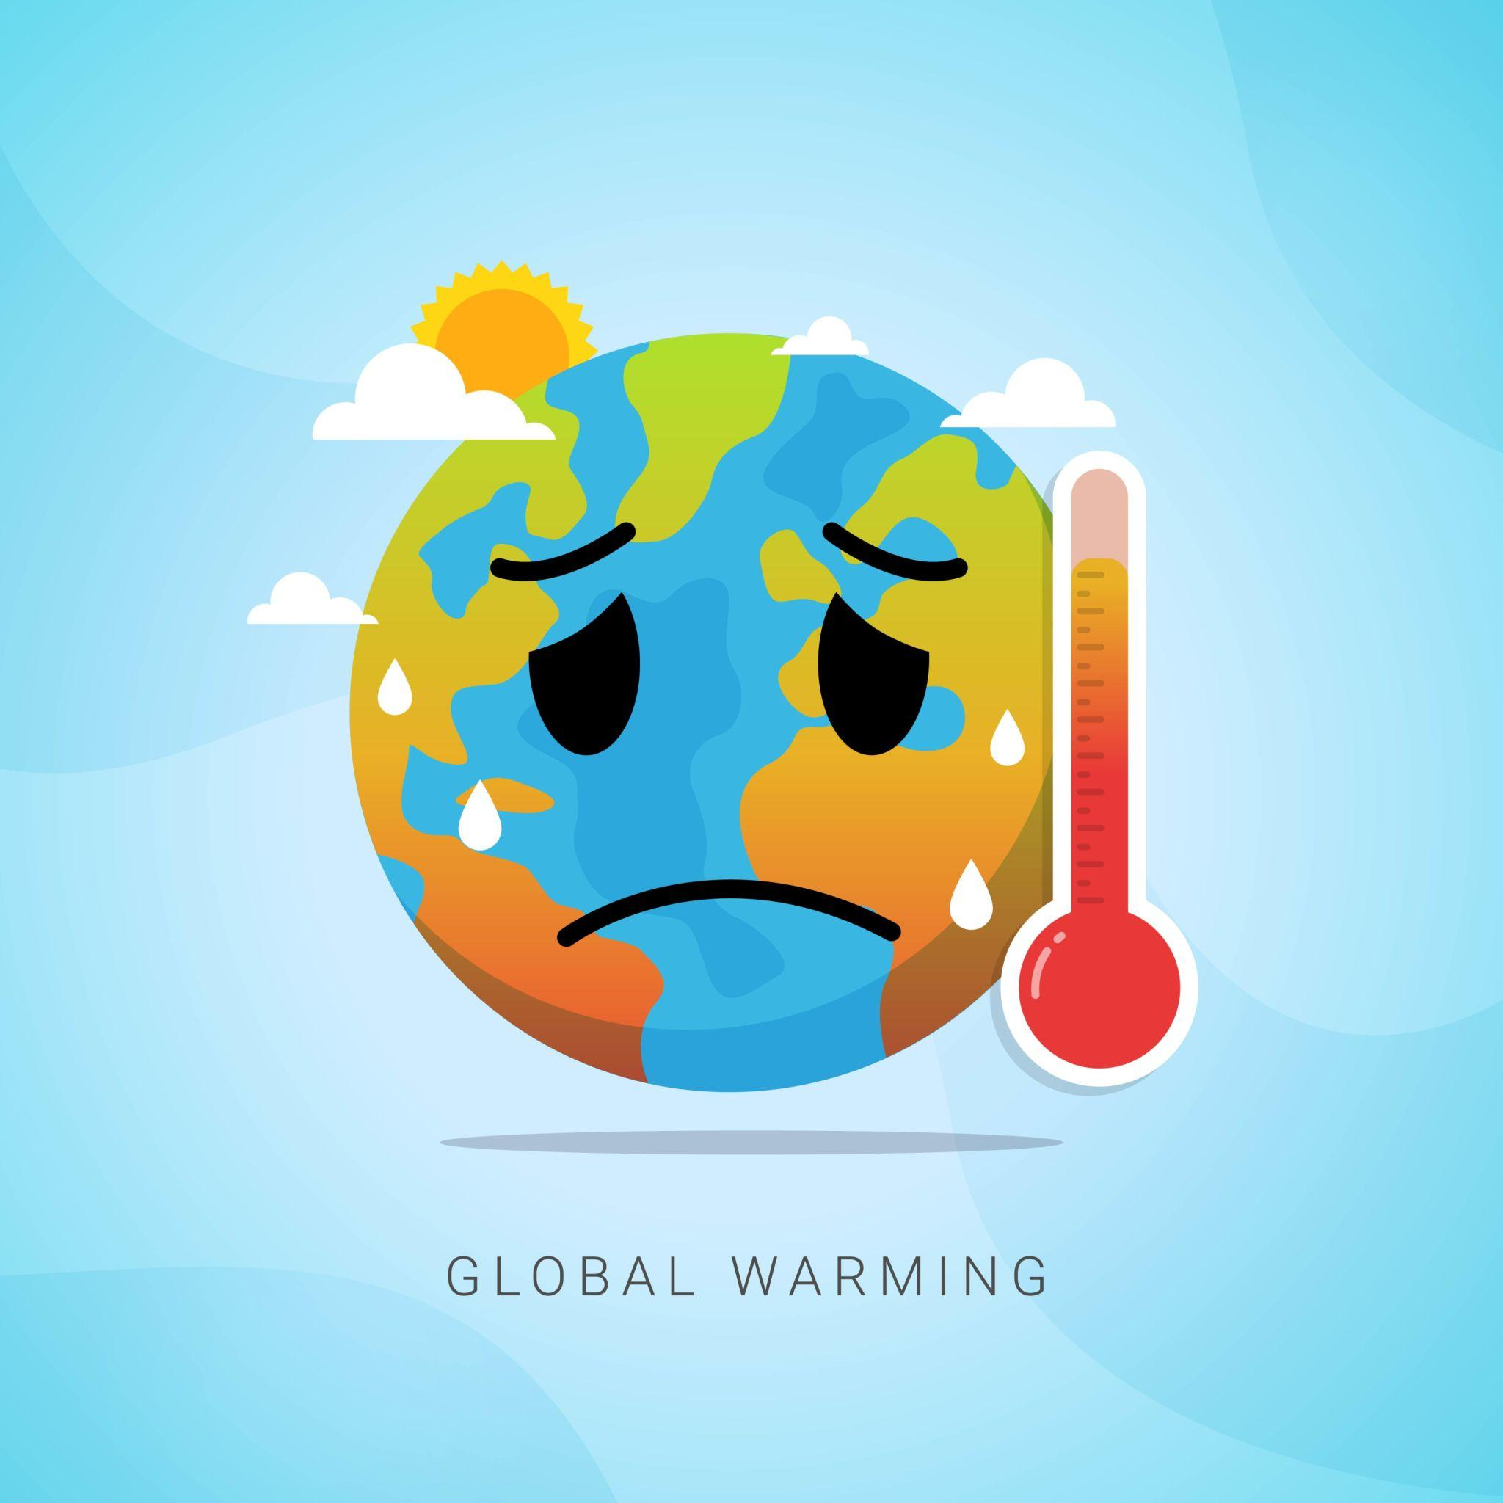
Agenda
Introduction
Human Activities On Climate Change
Scientific Evidence
Impacts of Climate Change
Policy Solutions
Advantages & Disadvantages
Conclusion

Slide 3

Introduction
Climate change is the long-term change in Earth's climate, mainly caused by human activities that increase greenhouse gases and trap heat in the atmosphere.
Climate change is one of the most pressing global challenges affecting both people and the environment.

Slide 4
Is Human Activities Cause Climate Change?

Slide 5
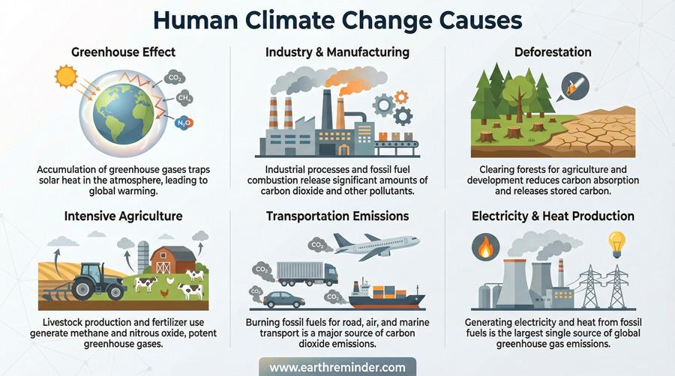
How Human Activities Cause Climate Change?
Human activities are considered as the primary cause of modern climate change.
Human activities release large amounts of greenhouse gases into the atmosphere.
These gases trap heat and warm the Earth.

Slide 6
How Human Activities Cause Climate Change?
Human activities are considered as the primary cause of modern climate change.
Human activities release large amounts of greenhouse gases into the atmosphere.
These gases trap heat and warm the Earth.

Slide 7
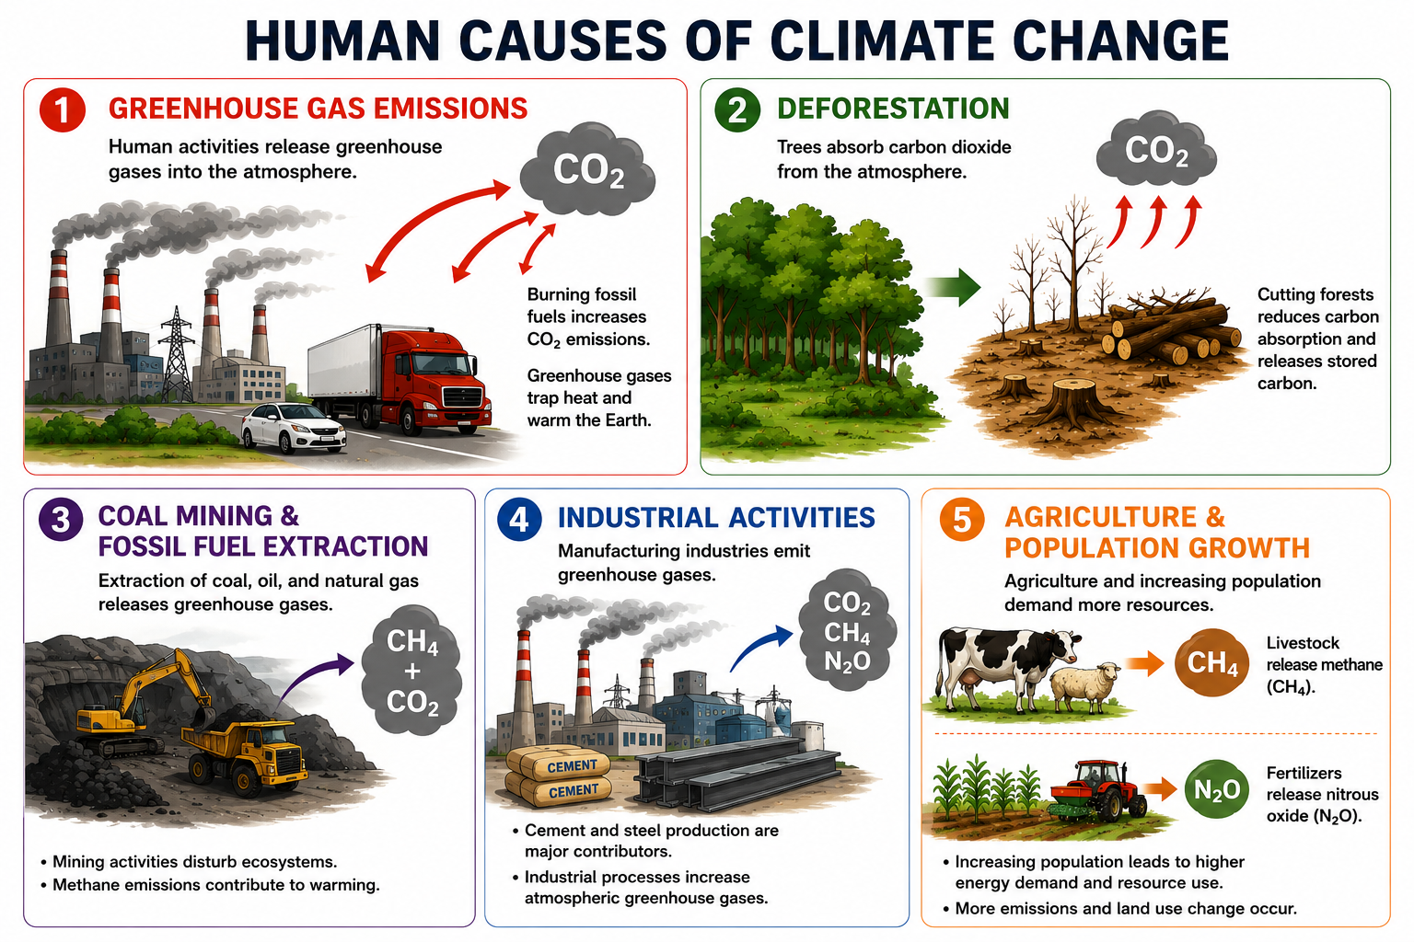
How Human Activities Cause Climate Change?

Slide 8
Scientific Evidence
Extreme weather events such as floods, droughts and heatwaves are increasing.
Maharashtra Drought (2016): Large parts of Maharashtra, especially the Marathwada region, faced severe drought due to low rainfall and depleting groundwater levels.
Kerala Floods, India (2018) – Climate monitoring and flood forecasting systems were used to predict heavy rainfall, issue early warnings, and assist evacuation and disaster management efforts, helping reduce loss of life and property.
Severe Heatwaves in Andhra Pradesh (2015): Extremely high temperatures affected thousands of people across the state, with many heat-related deaths reported
The Taj Mahal began showing noticeable pollution damage in the 1970s–1980s due to industrial emissions and acid rain.
“These observations provide strong evidence that climate change is occurring and affecting the planet.”

Slide 9
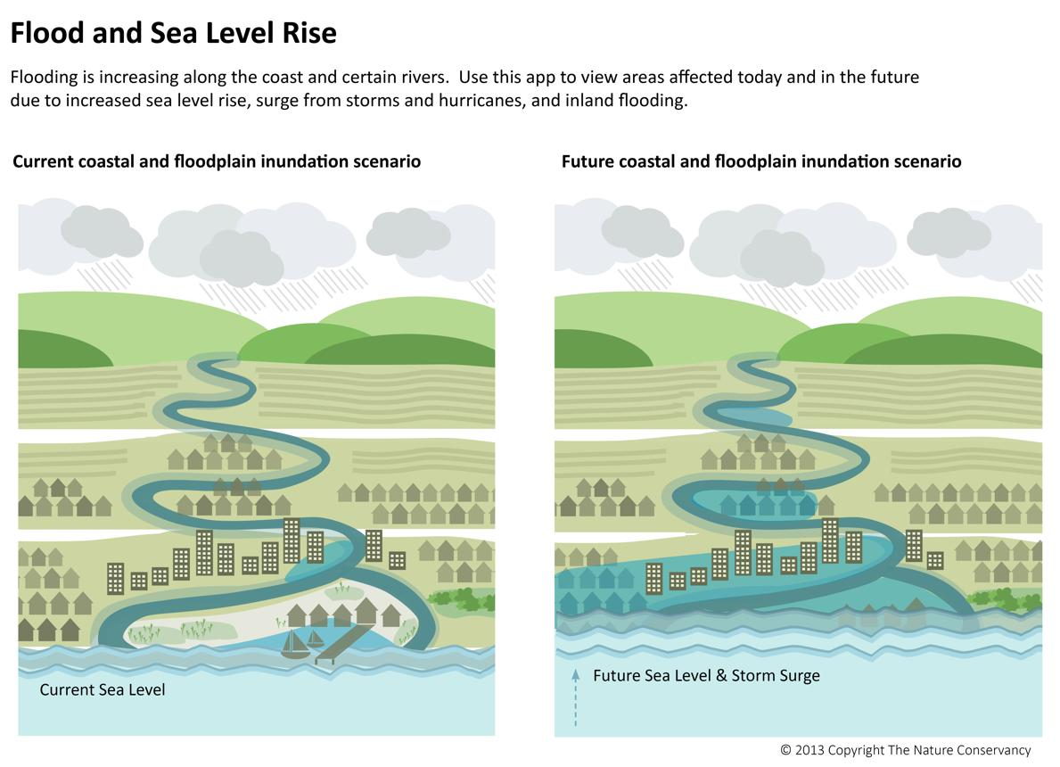
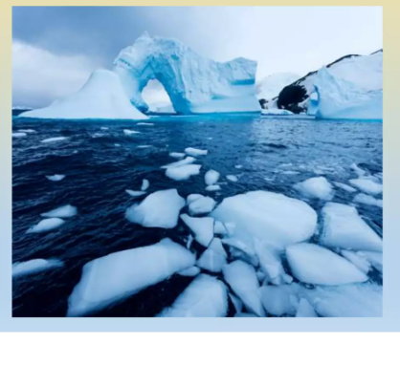
Impacts of Climate Change
Rising sea levels increase the risk of coastal flooding.
Heavy rainfall and droughts affect water resources and agriculture.
Higher temperatures lead to more frequent heatwaves.
Crop productivity declines due to changing climate conditions.
Ecosystems, wildlife habitats and marine life are increasingly affected.
Extreme weather events and heat-related health risks are becoming more common.

Slide 10
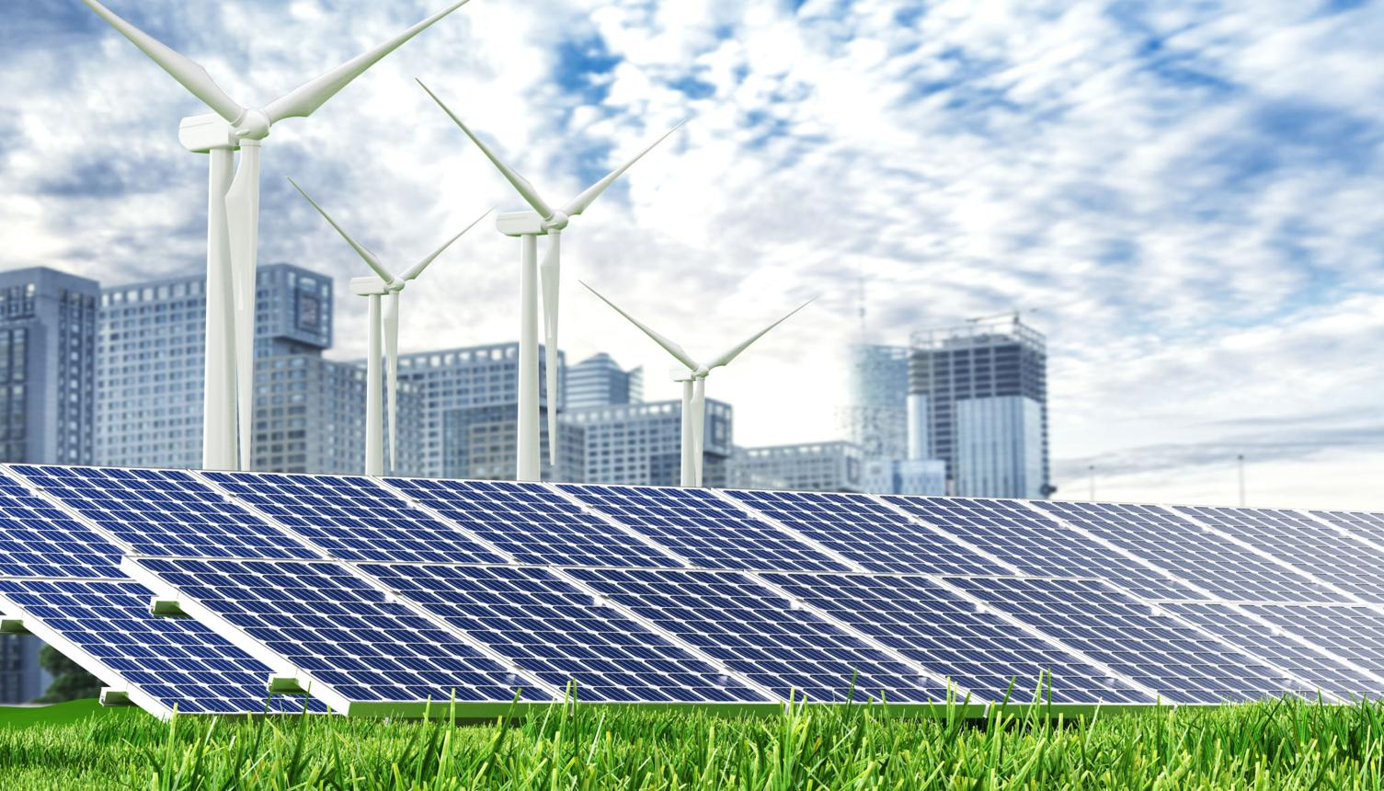
Policy Solution-1
Clean Energy Transition Policies
Expand solar power.
Expand wind power.
Reduce coal dependence.
Improve energy efficiency.
Invest in clean technologies.
Expected Outcome : Clean energy policies reduce greenhouse gas emissions by replacing fossil fuels with renewable and efficient energy sources.

Slide 11

Policy Solution-2
Protect and Restore Nature Policies
Reforestation programs.
Forest conservation.
Wetland restoration.
Sustainable agriculture.
Biodiversity protection.
Expected Outcome : Protecting and restoring nature helps absorb carbon dioxide, reduce climate impacts, and support a sustainable future.

Slide 12
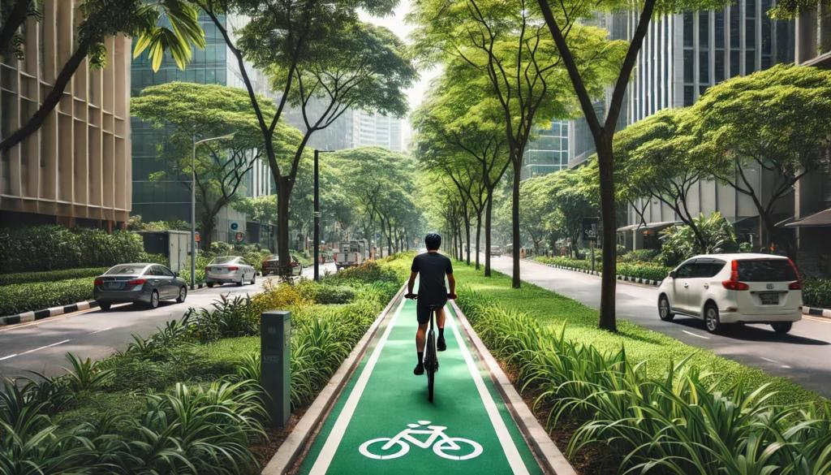
Policy Solution-3
Sustainable Transportation Policies
Promote electric vehicles.
Improve public transport.
Encourage cycling and walking.
Develop green infrastructure.
Expected Outcome : Reduced transportation emissions.

Slide 13
Advantages
Longer growing seasons in some cold regions -Parts of Uttarakhand.
Increased agricultural productivity in certain high latitude regions of Himachal Pradesh.
More rainfall in some dry regions- Parts of Rajasthan have experienced occasional increases in rainfall.
Reduced heating costs during milder winters-Northern hill regions may require less heating during milder winters

Slide 14
Disadvantages
Rising temperatures and frequent heatwaves.
Sea-level rise causing coastal flooding.
More extreme weather events such as floods, storms and droughts.
Reduced crop yields and food insecurity.
Loss of biodiversity and ecosystem damage.
Increased health risks from heat stress and diseases.
Water shortages in many regions.
Damage to infrastructure and economic losses.

Slide 15
Conclusion
Climate change is a major global challenge.
Human activities are the primary cause.
Scientific evidence strongly supports this conclusion.
Clean energy and environmental policies can reduce its impacts.
Global cooperation is essential for a sustainable future.
“Human activities are driving climate change, but effective policies and global cooperation can help create a cleaner, safer and more sustainable future for generations to come.”

Slide 16
Q/A

Slide 17
Thank You

